Slide 1

© 2007 Thomson South-Western

Slide 2
THE ELASTICITY OF SUPPLY
Price elasticity of supply is a measure of how much the quantity supplied of a good responds to a change in the price of that good.
Price elasticity of supply is the percentage change in quantity supplied resulting from a percentage change in price.

Slide 3
Figure 5 The Price Elasticity of Supply
(a) Perfectly Inelastic Supply: Elasticity Equals 0
Price
Supply
$5
4
1. An
increase
in price . . .
0
100
Quantity
2. . . . leaves the quantity supplied unchanged.

Slide 4
Figure 5 The Price Elasticity of Supply
(b) Inelastic Supply: Elasticity Is Less Than 1
Price
Supply
$5
4
1. A 22%
increase
in price . . .
0
100
110
Quantity
2. . . . leads to a 10% increase in quantity supplied.

Slide 5
Figure 5 The Price Elasticity of Supply
(c) Unit Elastic Supply: Elasticity Equals 1
Price
Supply
$5
4
(If SUPPLY is unit elastic and linear, it will begin at the origin.)
1. A 22%
increase
in price . . .
0
100
125
Quantity
2. . . . leads to a 22% increase in quantity supplied.

Slide 6
Figure 5 The Price Elasticity of Supply
(d) Elastic Supply: Elasticity Is Greater Than 1
Price
Supply
$5
4
1. A 22%
increase
in price . . .
0
100
200
Quantity
2. . . . leads to a 67% increase in quantity supplied.

Slide 7
Figure 5 The Price Elasticity of Supply
(e) Perfectly Elastic Supply: Elasticity Equals Infinity
Price
1. At any price
above $4, quantity
supplied is infinite.
$4
Supply
2. At exactly $4,
producers will
supply any quantity.
0
Quantity
3. At a price below $4,
quantity supplied is zero.

Slide 8
The Price Elasticity of Supply and Its Determinants
Ability of sellers to change the amount of the good they produce.
  Beach-front land is inelastic.
  Books, cars, or manufactured goods are elastic.
Time period
  Supply is more elastic in the long run.

Slide 9
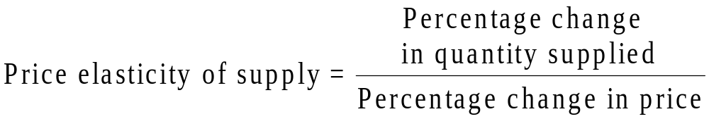
Computing the Price Elasticity of Supply
The price elasticity of supply is computed as the percentage change in the quantity supplied divided by the percentage change in price.

Slide 10
TWO APPLICATIONS OF SUPPLY, DEMAND, AND ELASTICITY
Can good news for farming be bad news for farmers?
What happens to wheat farmers and the market for wheat when university agronomists discover a new wheat hybrid that is more productive than existing varieties?

Slide 11
Can Good News for Farming Be Bad News for Farmers?
Examine whether the supply or demand curve shifts.
Determine the direction of the shift of the curve.
Use the supply-and-demand diagram to see how the market equilibrium changes.

Slide 12
Figure 7 An Increase in Supply in the Market for Wheat
Price of
Wheat
1. When demand is inelastic,
2. . . . leads
an increase in supply
. . .
to a large fall
S₁
in price . . .
S₂
$3
2
Demand
0
100
110
Quantity of
Wheat
3. . . . and a proportionately smaller
increase in quantity sold. As a result,
revenue falls from $300 to $220.

Slide 13
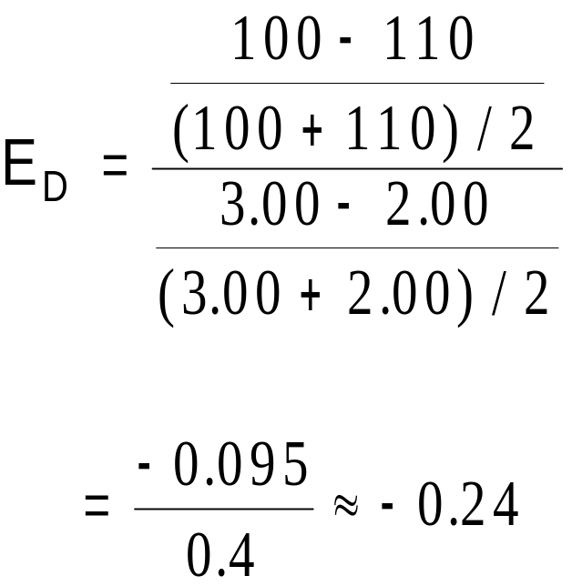
Compute the Price Elasticity of Demand When There Is a Change in Supply
Demand is inelastic.

Slide 14
Why Did OPEC Fail to Keep the Price of Oil High?
Supply and Demand can behave differently in the short run and the long run
  In the short run, both supply and demand for oil are relatively inelastic
  But in the long run, both are elastic
    Production outside of OPEC
    More conservation by consumers

Slide 15
Price elasticity of demand measures how much the quantity demanded responds to changes in the price.
Price elasticity of demand is calculated as the percentage change in quantity demanded divided by the percentage change in price.
  If a demand curve is elastic, total revenue falls when the price rises.
  If it is inelastic, total revenue rises as the price rises.

Slide 16
The income elasticity of demand measures how much the quantity demanded responds to changes in consumers’ income.
The cross-price elasticity of demand measures how much the quantity demanded of one good responds to the price of another good.
The price elasticity of supply measures how much the quantity supplied responds to changes in the price.

Slide 17
In most markets, supply is more elastic in the long run than in the short run.
The price elasticity of supply is calculated as the percentage change in quantity supplied divided by the percentage change in price.
The tools of supply and demand can be applied in many different types of markets.

